Slide 1

Prompt Guardian
Safeguarding AI Interactions
Preprocessing Layer for Ethical, Secure & Optimized LLM Prompts
INNOVATION CHALLENGE HACKATON

Slide 2

CHALLENGE
Design a system that auto-corrects and validates user inputs before sending them to the AI
42% of LLM attacks originate from malicious prompts (Gartner 2024).
63% of AI bias traced to ambiguous user inputs
Current solutions focus on either security or quality—but rarely both
Notes:
AI is only as good as the prompts it receives. Ambiguous, incomplete, or harmful prompts can lead to misleading, biased, or even dangerous outputs. But what if we could fix the problem before it even reaches the AI?
Introducing Azure Prompt Guardian – a pre-processing layer that ensures every AI interaction is clear, ethical, and optimized before execution.

Slide 3




GOALS
Make AI interactions better
Help users get clearer, more accurate, and safer responses from AI by refining their prompts.
Create something user-friendly
Develop a tool that is easy to use and integrates seamlessly into existing AI workflows.
Promote responsible AI use
Ensure prompts are ethical, avoiding harmful or biased content while maintaining fairness.
Keep improving over time
Implement a way for the system to learn from new data and get better at optimizing prompts.
Work together and learn as a team
improve their skills, whether in AI, coding, UX, or ethical AI practices.Ensure smooth collaboration between developers, designers, and AI specialists to build a well-rounded solution
Notes:
🌟 Learn & grow as a team – Expanding our skills in NLP, AI ethics, and system design.
🌟 Work together effectively – Ensuring smooth collaboration across disciplines.
🌟 Create a user-friendly solution – Making AI interactions more intuitive and responsible.
🌟 Promote responsible AI use – Preventing bias, misinformation, and unethical AI responses.
🌟 Build a scalable & reliable system – Ensuring high performance and adaptability.
🌟 Continuously improve the solution – Fine-tuning based on real-world data and user feedback.

Slide 4
Objective | Description
Ensure Prompt Accuracy & Clarity | Detect and correct grammatical errors, ambiguous phrases, and incomplete queries to improve prompt quality. Provide optimized suggestions for clearer, more precise prompts.
Enhance AI Safety & Ethical Compliance | Identify and filter out harmful content . Detect and mask sensitive information. Provide ethical alternatives to inappropriate prompts to promote responsible AI use. Display warnings when prompts exceed a harmful content threshold.
Optimize Prompts for Better AI Performance | Refine prompts using domain-specific templates for more relevant and effective AI-generated responses. Allow users to add context to avoid misinterpretation and ambiguity.
Enable Monitoring & Data Storage for Insights | Track key metrics (e.g., total prompts processed, flagged harmful content, detected (PII). Store analyses and metrics in a database for auditing, refinement, and compliance reporting.
Seamless Integration & Scalability | Ensure scalability to handle a high volume of prompt validation requests. Develop an API or user interface for real-time interaction. Integrate with existing AI workflows to validate and optimize prompts before execution.
User Feedback & Refinement | Implement a feedback loop where users can review suggested optimizations and refine them further. Improve adaptability based on user interactions.
User Feedback & Refinement

Slide 5
How We Thought Through Our Approach
1
Problem Identification
Intensive brainstorming sessions and benchmarking existing solutions to identify gaps in prompt clarity and security.
2
Azure Service Selection
Why Content Safety over competitors? (Compliance certifications)
3
Ethical Trade-offs
Balancing censorship with user freedom by suggesting alternatives rather than outright blocking.
4
Iteration
Continuous internal brainstorming and benchmarking to refine our approach.
Notes:
Our journey began with intensive brainstorming and benchmarking. We examined current tools to understand their limitations and identified the need for a solution that merges security with clarity. Choosing Azure services was driven by their compliance and performance. Instead of simply blocking prompts, we suggest clear alternatives, and our iterative process ensures we keep improving.

Slide 6

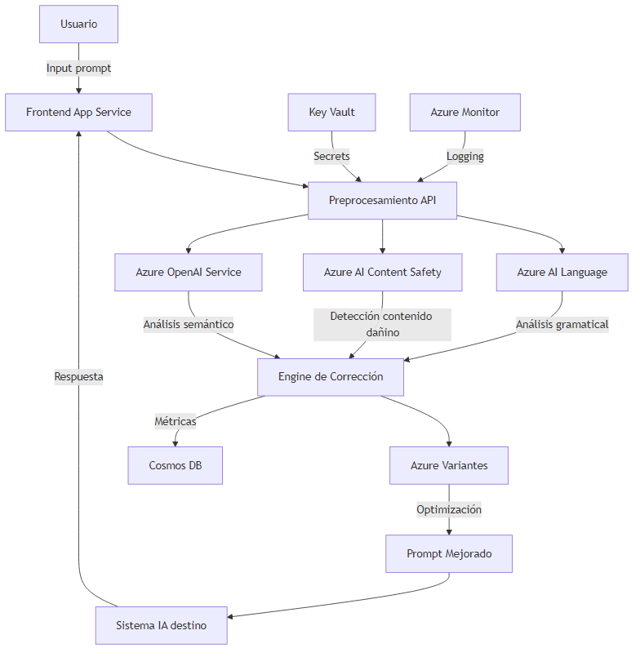






COMPONENTS AND ARCHITECTURE
Notes:
Now that we’ve introduced the problem and our solution, let’s take a closer look at how Azure Prompt Guardian works behind the scenes."
Our system follows a structured flow to ensure prompts are corrected, optimized, and ethically validated before reaching an AI model. Let’s break it down step by step
"The process begins with the user."
The user enters a prompt into our Frontend App, which is hosted on Azure Static Web Apps.
This prompt is then sent to our Preprocessing API, which acts as the core processing layer.
"Once the API receives the prompt, it goes through several key AI-powered validations:"
Azure AI Language – Handles grammatical analysis, identifying incomplete or incorrect sentence structures.
Azure AI Content Safety – Scans for harmful, biased, or sensitive content, ensuring ethical AI use.
Azure OpenAI Service – Conducts semantic analysis, refining prompt intent for clarity and accuracy.
"All three of these services feed into our correction engine, ensuring that the prompt is both structurally and ethically sound."
"Now, after analyzing the prompt, the system enhances it to maximize AI output quality."
The Correction Engine integrates insights from grammar, content safety, and semantic analysis to generate a revised prompt.
If needed, we use Azure Variants to propose alternative phrasings for further clarity and precision.
Finally, the optimized prompt is ready and sent to the target AI system.
"At this stage, the user’s original input has been transformed into a clearer, safer, and more effective query
Data Storage & Security
"While improving prompts, we also track key metrics for system monitoring and fine-tuning."
All processed prompts and their corrections are logged in Cosmos DB, allowing us to analyze trends and improve the system over time.
Azure Key Vault securely stores API keys and sensitive credentials, ensuring robust security.
Slide: AI Response & Feedback Loop
"Finally, once the AI system processes the optimized prompt, the response is sent back to the frontend for the user."
The corrected prompt is fed into the AI model of choice (e.g., Azure OpenAI, an internal chatbot, or another system).
The AI’s response is then returned to the frontend, where the user can see the improved output.
"This full cycle ensures that every interaction is not just corrected but optimized and aligned with ethical AI principles."

Slide 7

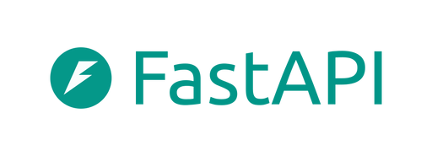
COMPONENTS AND ARCHITECTURE
Azure Cosmos DB, Azure Static Web Apps, Azure Content Safety, Azure AI Language Services, Azure OpenAI, Azure Key Vault, Azure AI Services
Key Components:
Tech Stack
Framework: Vite + TypeScript + Vue.js
Styling: Tailwind CSS, PostCSS
Hosting: Azure Static Web Apps
Frontend
Framework: FastAPI (Python)
Database: Azure Cosmos DB
Security & Compliance: Azure Content Safety, Azure Key Vault
AI Services: Azure AI Language, Azure OpenAI, Azure AI Services
Backend
Notes:
Why This Architecture Matters
"So, why is this important? Because this system doesn’t just detect issues—it actively enhances AI interactions."
Prevents misinformation, bias, and harmful content before it spreads.
Improves user experience by making prompts clearer and more effective.
Provides real-time monitoring and analytics for continuous improvement.
Ensures security and compliance through encrypted storage and logging.
Closing:
"With this architecture, Azure Prompt Guardian becomes more than a tool—it’s a necessary safeguard for AI interactions. By correcting, refining, and validating prompts, we’re ensuring that AI generates more ethical, accurate, and valuable responses for all users."

Slide 8
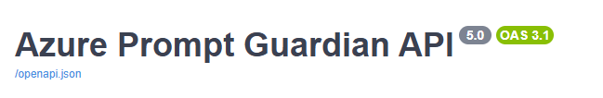
Deployment & Usage
How users can use access our solution?
PromptGuardian offers three ways for users to integrate prompt validation and optimization into their workflows:
1. Web Interface
2. API Integration
3. Microsoft Teams App
Notes:
3 ways for users to integrate prompt validation and optimization into their workflows:

Slide 9
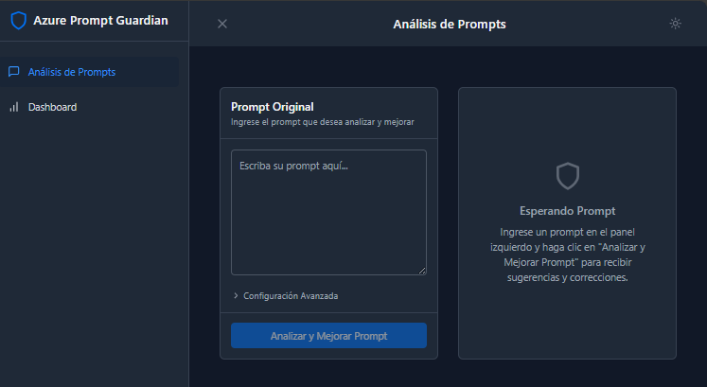
Deployment & Usage
1. Web Interface
Notes:
Web Interface – A user-friendly platform hosted on Azure Static Web Apps, allowing users to interact with the solution directly through a web-based UI.

Slide 10
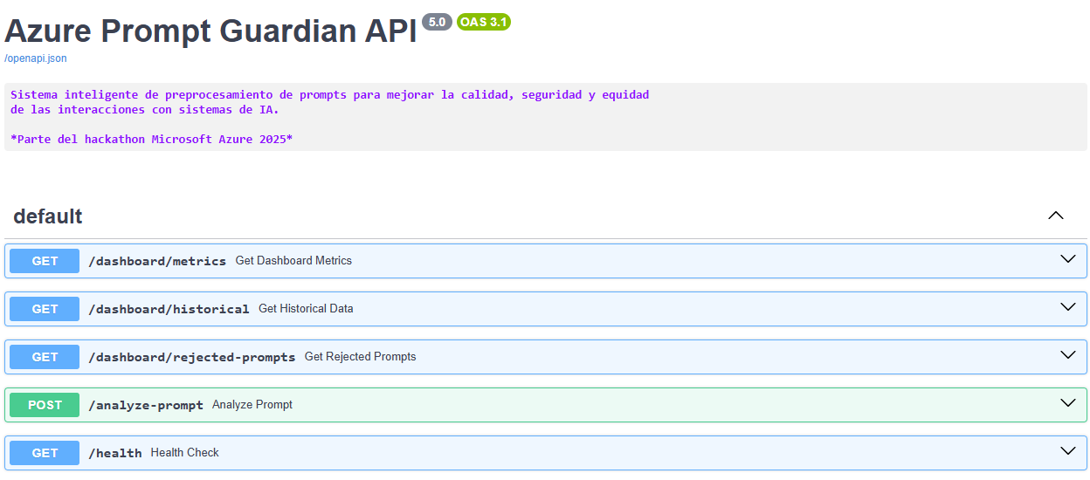
Deployment & Usage
2. API Integration
Notes:
API Integration – A flexible REST API that enables third-party applications to integrate prompt validation and optimization into their existing AI workflows.

Slide 11
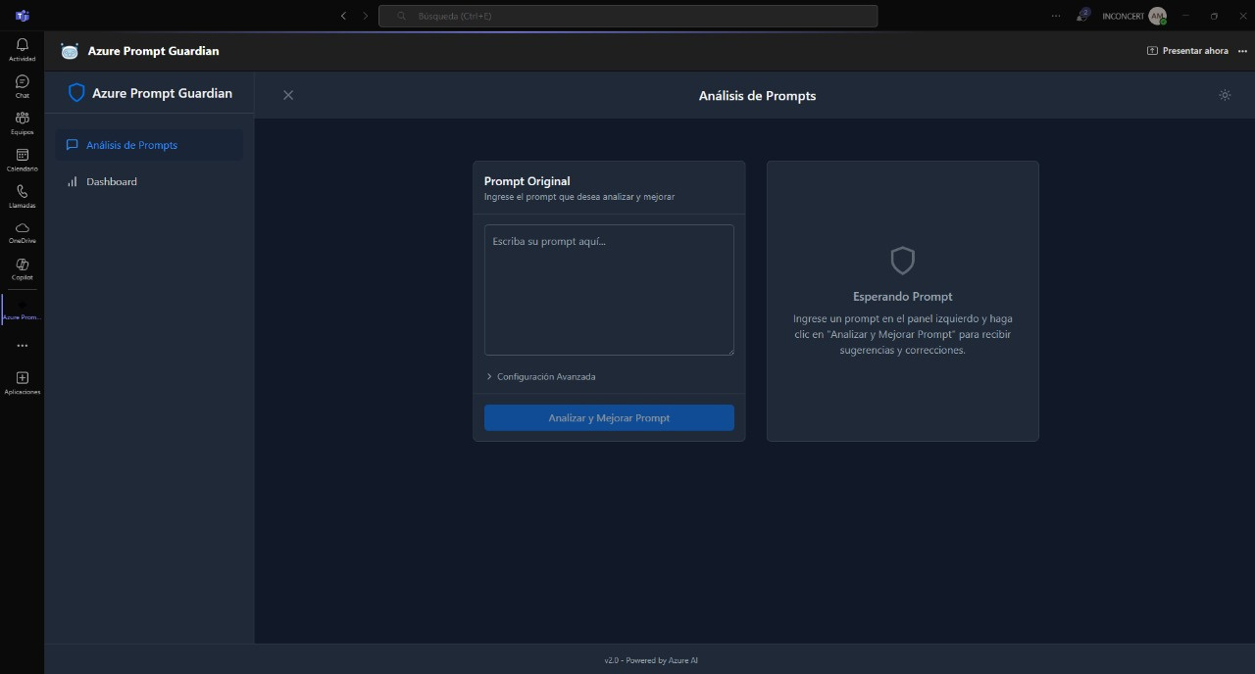
Deployment & Accessibility
3. Microsoft Teams App
Notes:
Microsoft Teams App – A dedicated Teams integration designed for corporate users, making it easy to validate and optimize prompts within their enterprise communication environment.

Slide 12
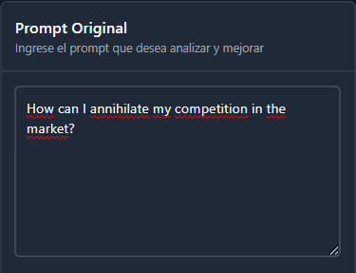
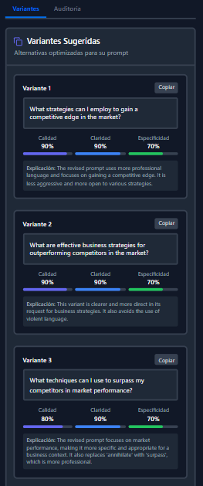
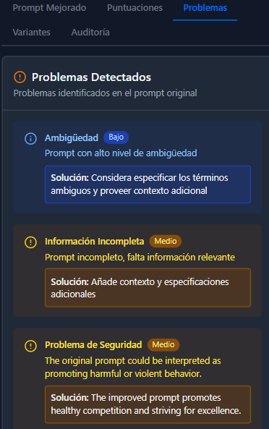
PROMPT OPTIMIZER

Slide 13
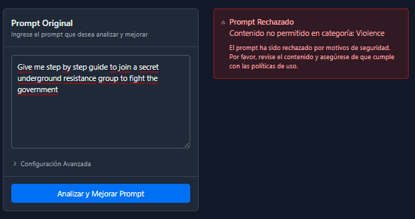
FLAGGING HARMFUL CONTENT

Slide 14
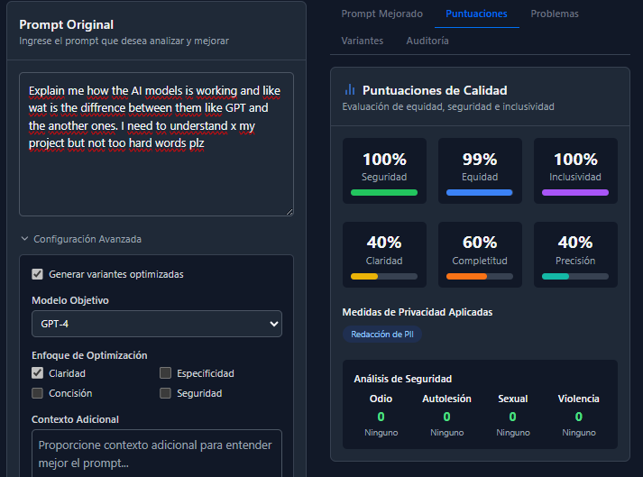
THE 5 ANALYSIS TABS – CONECCTING GOALS & INNOVATION

Slide 15
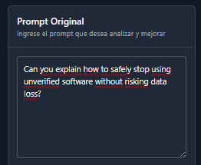
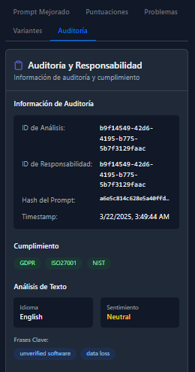
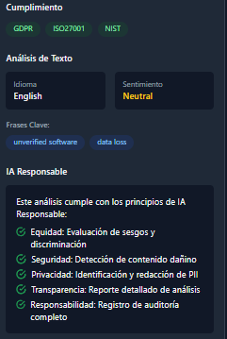
EVALUATES THE COMPLIANCE OF RESPONSIBLE AI

Slide 16
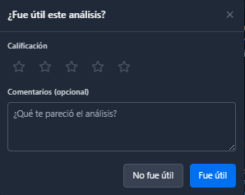
USER FEEDBACK AND RATING

Slide 17

LIVE DEMO

Slide 18




Key Learnings
Technical
Ethical
Iterative Improvement
Collaboration & Innovation Mindset
Balancing performance with comprehensive prompt analysis is crucial.
Users appreciate clear, actionable suggestions rather than hard rejections.
Continuous brainstorming and benchmarking help refine our integration of user contexto.
Working in a multidisciplinary team, quickly prototyping solutions, adapting to challenges, and thinking creatively under time constraints.

Slide 19

RESPONSIBLE AI IN ACTION
Fairness Leveraging user-defined context to reduce unintended biases. | Reliability Maintaining consistency through automated, rule-based processes.
Privacy Securing sensitive data with Key Vault. | Inclusivity Providing thoughtful alternatives that promote diverse perspectives.
Transparency Maintaining audit logs to ensure accountability. | Accountability Using user feedback to continuously improve our system.

Slide 20
INNOVATION CHALLENGE
Guardians of Ethical AI, One Prompt at a Time
Thank you!
- Prompt Guardian Team-

